Slide 1
Excitable media:
From cells to tissues

Slide 2
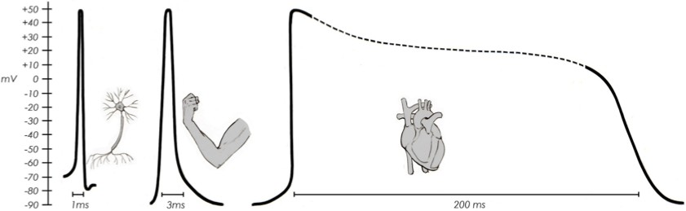
Electrophysiology signal-transduction is happening across many organs
While the brain still needs a cellular-level understanding of simulations electrophysiology of the heart occurs on larger scales

Slide 3
Cardiac dynamics

Slide 4
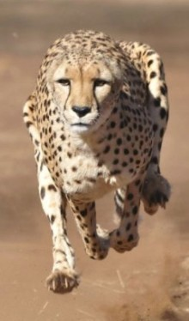
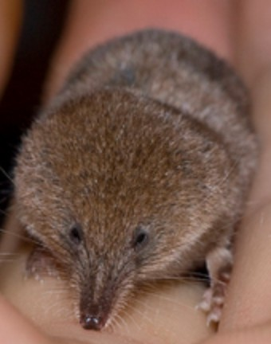
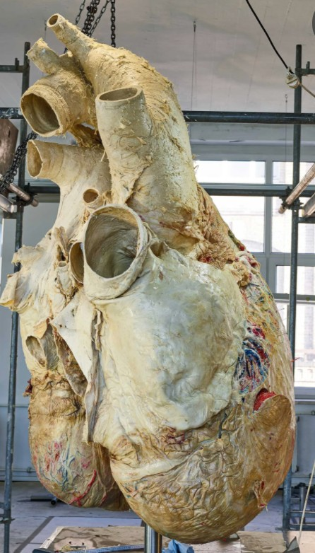
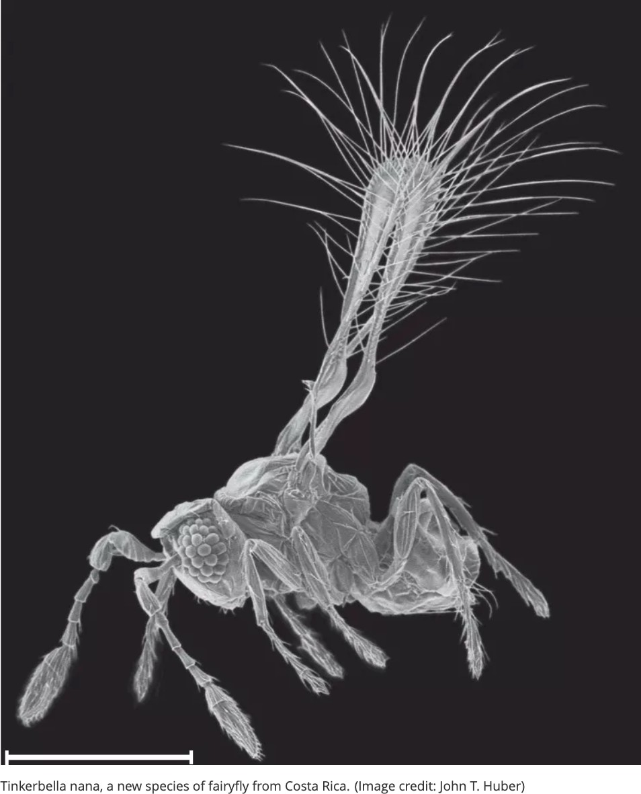
Some animal hearts are amazing
The cheetah. One of the fastest land animals, its resting heart beat is about 120 beats per minute, similar to a jogging human. Here’s the difference: The cheetah can go up to 250 BPM in just a few seconds
The Etruscan shrew. The Etruscan shrew is the smallest mammal by mass (2 grams) and has a heart rate of 25 beats per second. That’s a 1,500 BPM!
The smallest animal hearts belong to the
.006-inch long fairyflies
The largest animal heart is the blue whale’s, 400 pounds (180 kg) and roughly the size of a bumper car. As a blue whale dives to feed, its giant heart may only beat twice per minute

Slide 5
Motivation – Heart Disease Remains a Leading Cause of Mortality
National Vital Statistics Report, Vol.49, No.11, October 12, 2006 Deaths and percent of total deaths for the 10 leading causes of death: United States
Rank Cause of death Total Deaths Percentage
All causes ..................................................................2,391,399 | 100.0
1 Diseases of heart ................................................725,192 | 30.3
2 Malignant neoplasms ...........................................549,838 | 23.0
3 Cerebrovascular diseases .....................................167,366 | 7.0
4 Chronic lower respiratory diseases ......................124,181 | 5.2
5 Accidents (unintentional injuries)...........................97,860 | 4.1
6 Diabetes mellitus ....................................................68,399 | 2.9
7 Influenza and pneumonia .......................................63,730 | 2.7
8 Alzheimer’s disease ...............................................44,536 | 1.9
9 Nephritis, nephrotic syndrome and nephrosis ........35,525 | 1.5
10 Septicemia .............................................................30,680 | 1.3
All other causes ....................................................484,092 | 20.2
http://www.cdc.gov/nchs/data/nvsr/nvsr57/nvsr57_14.pdf
The breakdown of (ir)regular rhythms requires an understanding of nonlinear dynamics (and maybe some chaos)…

Slide 6
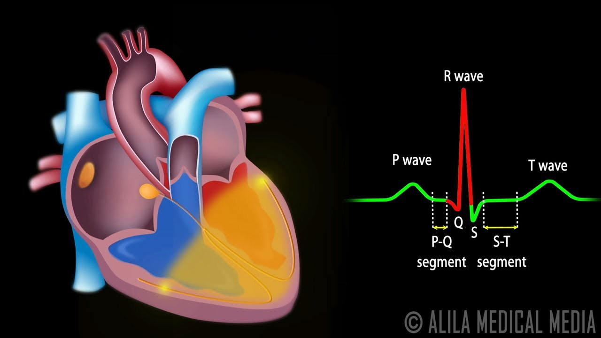
Some biology
- different chambers, flow, electrical signals
https://www.youtube.com/watch?v=RYZ4daFwMa8

Slide 7
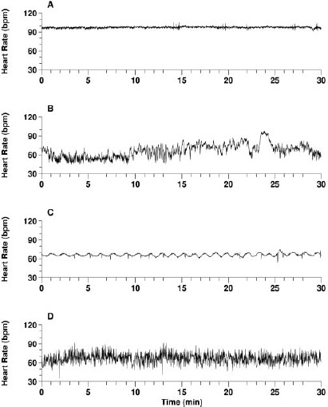
Spot the “Healthy” Heart
Severe congestive heart failure
Healthy - allostatic patchiness
Severe congestive heart failure
Cardiac arrhythmia – atrial fibrillation
Goldberger et al., PNAS, 99: 2466-2472 (2002)

Slide 8
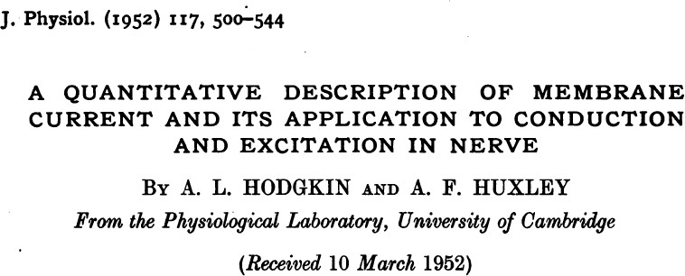
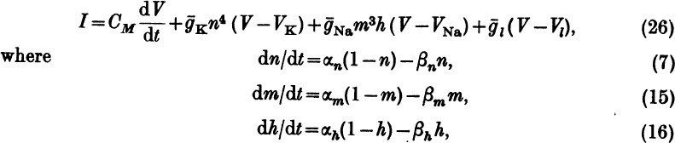
As we saw, the HH model is a bit too complex to understand…
And perhaps not all the details are the same across systems and not all the details matter!

Slide 9
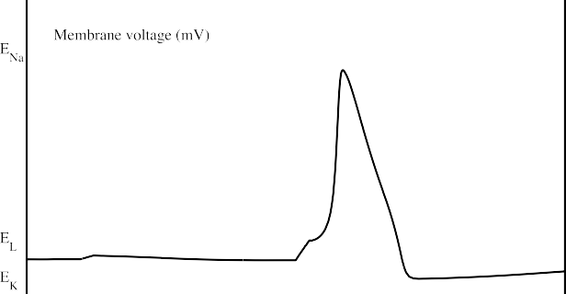
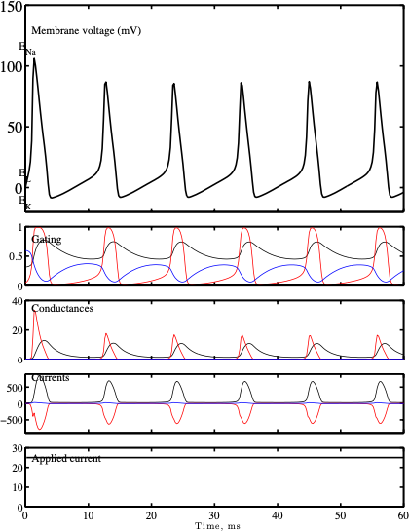
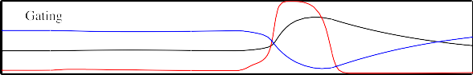
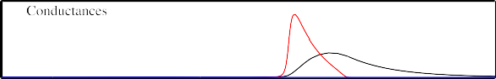
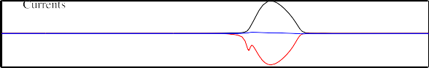
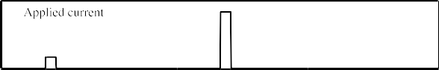
Typical HH results
Single-action potential given applied current past a threshold
Regular “beating” given a constant applied current

Slide 10
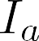
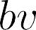
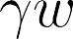
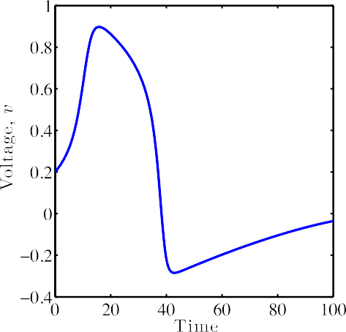
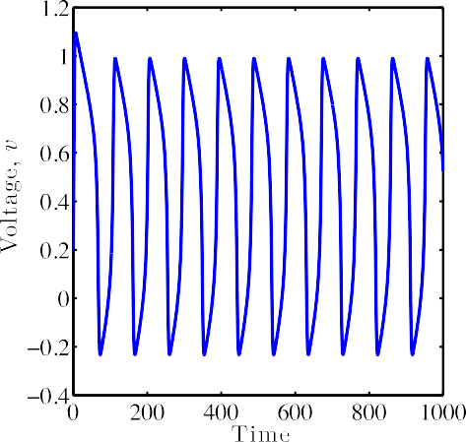
Alternative representation of the excitable system with input “current”
Voltage
Gating/recovery variable
FAST
SLOW
Filters “weak” input, here, v₀ = 0.01
Is ”excitable” given intermediate input, here, v₀ = 0.2
Exhibits “regular” beating for large and constant input, here I_{a} = 0.15

Slide 11
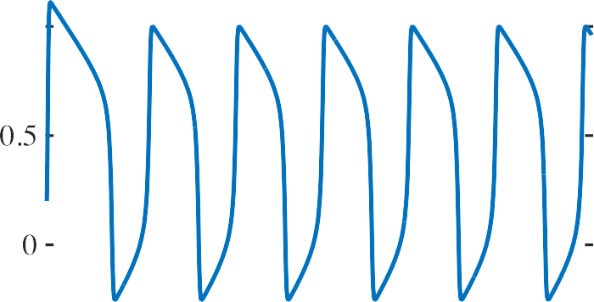

Limit cycle for constant critical current
Voltage
Gating/recovery variable
Exhibits “regular” beating for large and constant input, here , I_{a} = 0.15

Slide 12
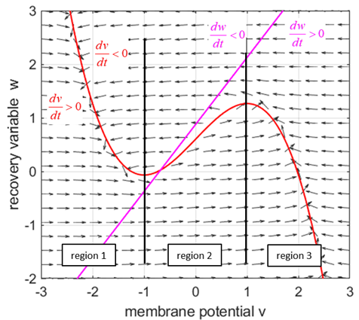
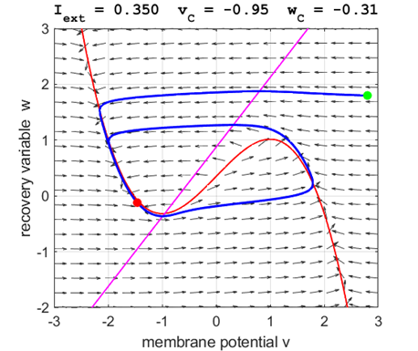
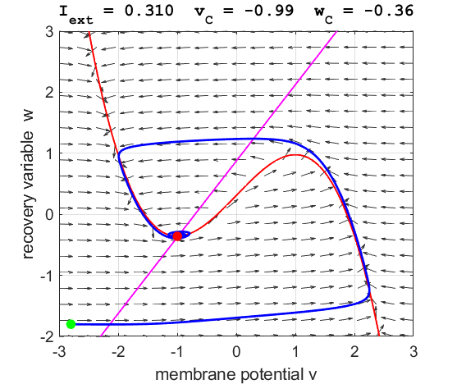
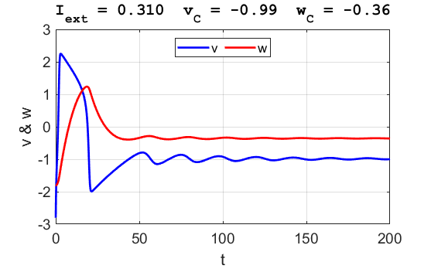
Dynamic System Analysis

Slide 13
Excitable media:
Including spatial dimension

Slide 14
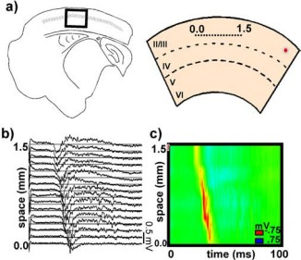
Excitable media
E.g., waves in the brain
Pinto, David J., et al. Journal of Neurosci. (2005)

Slide 15
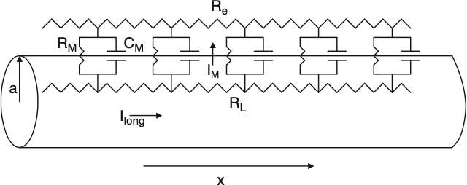
1D Cable equation
consider a cell shaped as a long cylinder, or cable, of radius a
Current flow along a single spatial dimension,
The cable equation is a partial differential equation that describes how the membrane potential V(x,t) depends on currents entering, leaving, and flowing within the neuron
Geometry affects the spread of the signal will help determine whether the synaptic input will cause the cell to fire an action potential

Slide 16
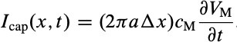
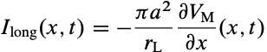
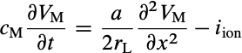
1D Cable equation - quick derivation
Kirchoff’s law:
Currents:
Current flow along a single spatial dimension,
Reaction-diffusion equation

Slide 17
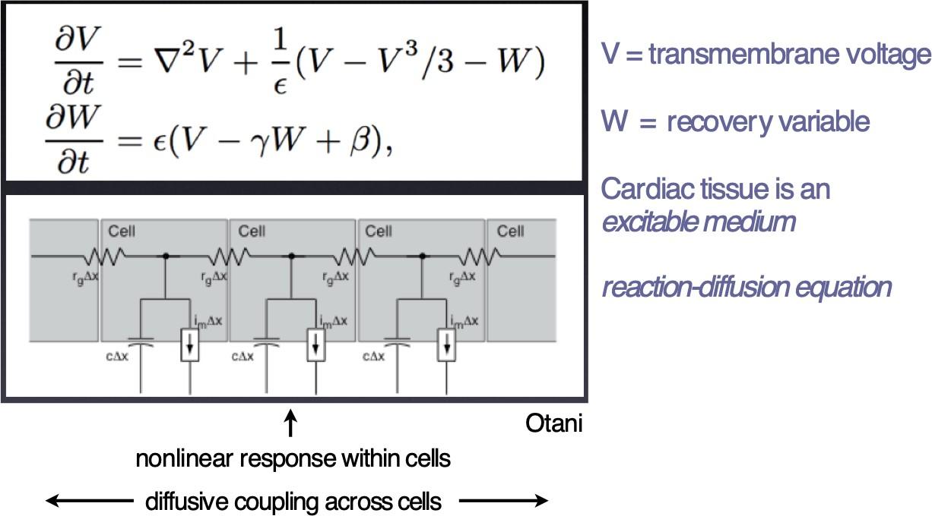
Fitzhugh-Nagumo proposed and analyzed a 1/2D model of “excitable media”

Slide 18
Reminder from BIOE 391
We classify 2nd order PDE au_{xx}+bu_{xy}+cu_{yy}+du_{x}+eu_{y}+fu+g=0:
b²-4ac < 0 – elliptic (e.g. Laplace eq:
u_{xx} + u_{yy} =0 (b=0,a=c=1)
b²-4ac = 0 – parabolic (e.g. diffusion) u_{t} - u_{xx} =0 (b=0,a=0, c=1)
b²-4ac > 0 – hyperbolic (e.g. wave motion)
u_{tt} - u_{xx} =0 (b=0,a=1, c=-1)
Space:
Boundary conditions on the domain ends (e.g. fixed concentrations or flux/derivative value)
3 points needed to approximate second derivative
Time:
Initial conditions, not boundary conditions
Often, open-ended interval that can be large (or even infinite)
Two points sufficient for time derivatives
We are interested in the scheme converging to steady states so we don’t want errors to accumulate as we take more time-steps

Slide 19
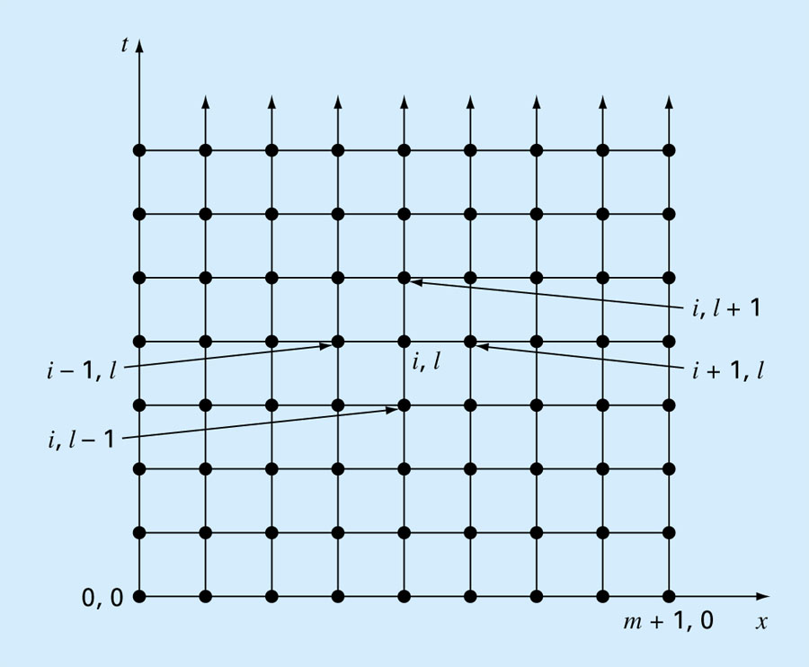
Figure 30.2: Possible discretization of 1D diffusion PDE

Slide 20
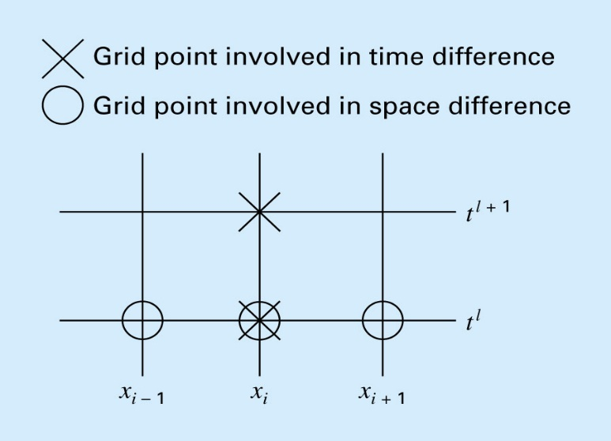
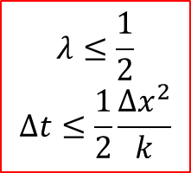
Explicit Methods
The heat conduction equation requires approximations for the second derivative in space and the first derivative in time:
Superscript – time
Subscripts - space
$$λ≤\frac{1}{2}$$
$$Δt≤\frac{1}{2}\frac{Δx^{2}}{k}$$
New time-point calculated from old time-point for several spatial points

Slide 21
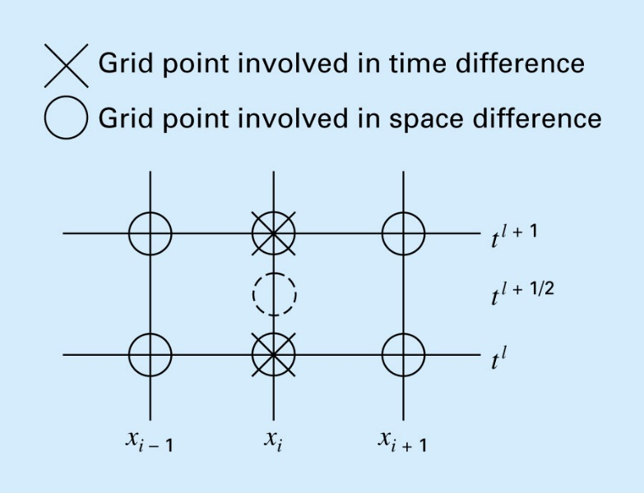
Implicit: Crank-Nicolson Method
Provides an alternative implicit scheme that is second order accurate in both space and time.
To provide this accuracy, difference approximations are developed at the midpoint of the time increment:
An average of the 2nd-order derivative at 2 time points, current (l+1) & previous (l)

Slide 22
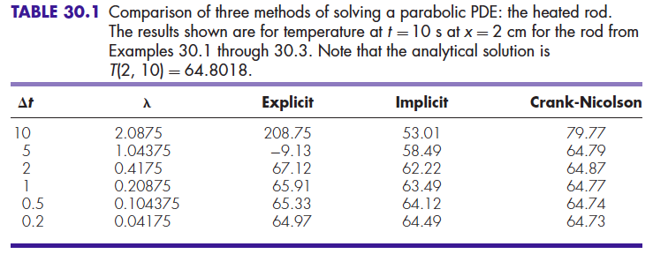
Crank Nicholson Algorithm
m equations for m unknowns at each t
Crank-Nicolson method is better

Slide 23
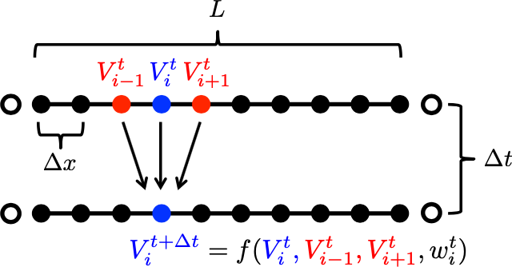

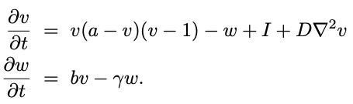

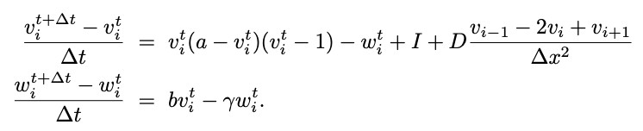


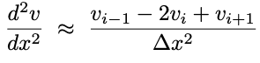
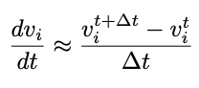
We will use the Explicit finite difference method:
FN 1D spatial model:
Discrete approximation

Slide 24
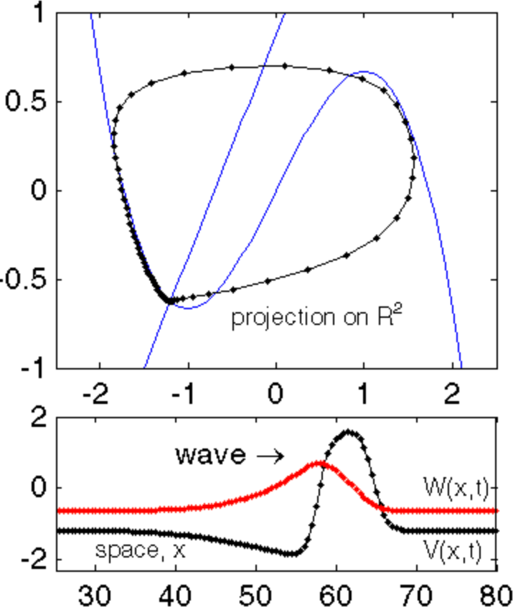
Wave propagation in the 1D spatially distributed FN model

Slide 25
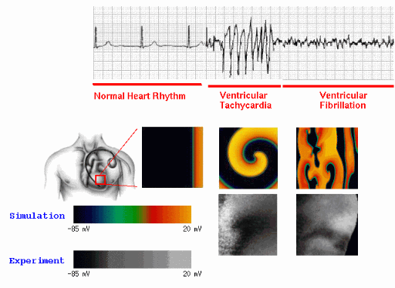
2D simualtions:
https://thevirtualheart.org/FHNindex.html
Also: https://youtu.be/CvBa6L3gIVc?si=wumVqdflcNXHkWPi

Slide 26
Visualizing cardiac behavior

Slide 27
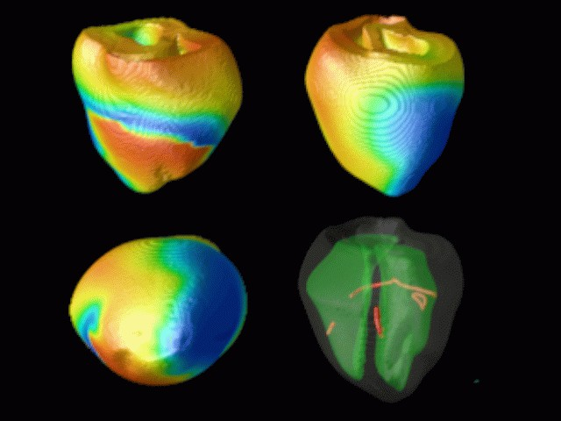
The FN model can be used to characterize complex neuronal and cardiac dynamics

Slide 28
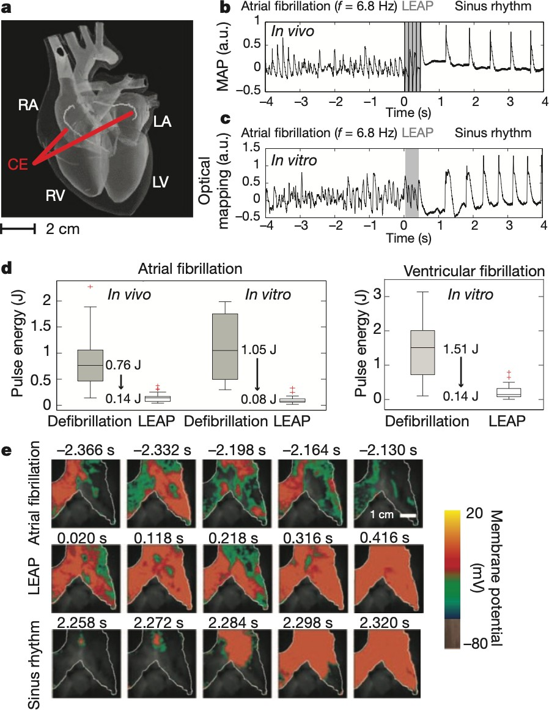
Restoring sinus rhythms with lower- energy electrical stimulus
A sequence of 5 low-energy electric field pulses (LEAP)
Average energy reduction: 84% in vivo and 91% in vitro using LEAP compared to standard defibrillation
Low-energy termination of cardiac electrical turbulence
Luther, Stefan, et al. Nature (2011)

Slide 29
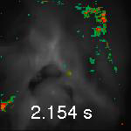
Visualizing cardiac behavior
Healthy behavior
https://static-content.springer.com/esm/art%3A10.1038%2Fnature10216/MediaObjects/41586_2011_BFnature10216_MOESM325_ESM.mov
Luther, Stefan, et al. Nature (2011)

Slide 30
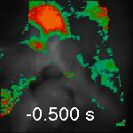
Visualizing cardiac behavior
Atrial fibrillation: stimulus -> entrainment
https://static-content.springer.com/esm/art%3A10.1038%2Fnature10216/MediaObjects/41586_2011_BFnature10216_MOESM324_ESM.mov
Luther, Stefan, et al. Nature (2011)

